Slide 1

Ongwediva Medipark “Hospital of the Future”
A high-level IT Strategy for Ongwediva Medipark

Slide 2


MEDIPARK VISION & PROBLEM STATEMENT

Slide 3
Ongwediva Medipark IT Strategy
Medipark Vision and Problem Statement (Business Case)
Problem:
Analyse and re-engineer current manual processed to identify inefficiencies which can be addressed by use of technology
Enhance current ICT Infrastructure to create an adaptable foundation for future expansion and growth
Implement Change Management to mature ITIL related processes and buy-in from stakeholders
Provide training, skills transfer and capacity building of Medipark personnel
Provide supervision and project management of Electronic Patient Management System and ICT Infrastructure upgrade
Solution:
Review the AS-IS, identify gaps and inefficiencies and recommend the “To-Be” process
Provide a management report and a project plan detailing status of the ICT landscape and whether it is sufficient to support the desired “TO-BE/SHOULD-BE” state.
Create and embed a Change Management culture which caters for both Technology and People Change
Develop a Framework:
Identify stakeholders
Conduct skills gap analysis
Objectives and Milestones
Define Skills transfer strategy
Provide a proposal for “Phase 2” (Supervision and Project Management of Hospital of the Future system)
Medipark Vision: To create a financially stable and sustainable business that delivers quality healthcare and establish a Centre of Excellence in Healthcare contributing towards the realization of Vision 2030”
page
03

Slide 4
OUR APPROACH IN ENABLING THE BUSINESS

Slide 5
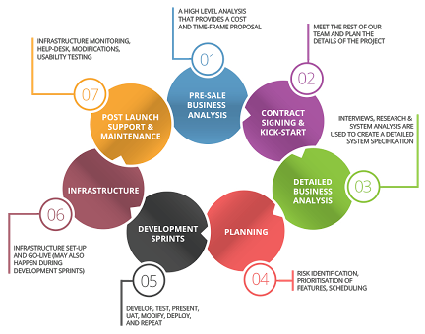
Ongwediva Medipark IT Strategy
Project Approach – Building the Integrated Hospital Management System
page
07

Slide 6

Ongwediva Medipark IT Strategy
Project Approach
Deliverable: Provide detailed report reflecting current enterprise-wide view
Deliverable: Implement, measure and
Maintain.
Phase 1 –
Define Objectives and Business Project Framework
1. Emphasis on Organisational and People Change Management
2. Provide Training and Development Strategy
3. Build functional team
Design “To-Be” Process
1. Benchmark each sub-process against best practice
2. Design “To-Be” process
3. Validate the new process through piloting
4. Design “To-Be” ICT landscape
02
04
Map and Analyze “As Is” Patient Management Process
1. Create current processes and sub-processes
2. Identify and analyze inefficiencies
3. Assess current ICT landscape
Implement Re-Engineered Process and Hospital of the Future Solution
1. Develop and evolve implementation plan
2. Develop test plans and test cases for the re-engineered process
01
03
Deliverables: BPR Framework, Training Strategy and Project Team
Deliverable: Provide enterprise-wide view of the future state and implementation plan
page
08

Slide 7
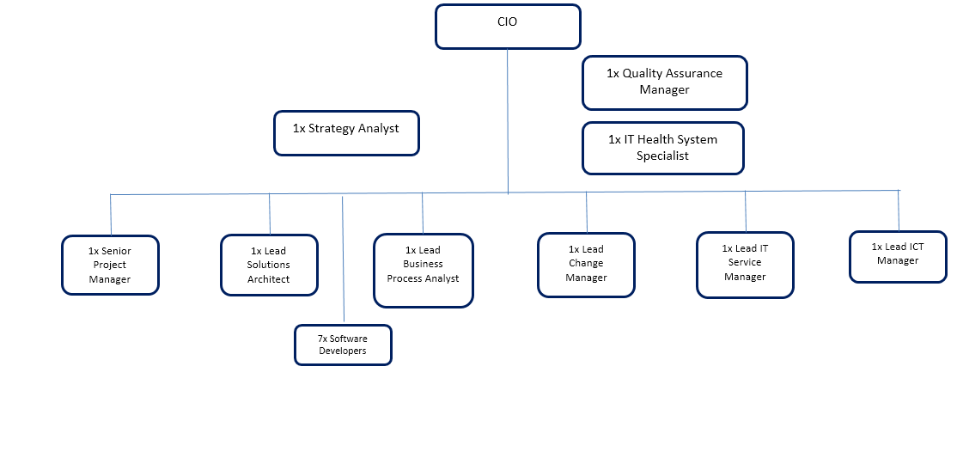
Ongwediva Medipark IT Strategy
The Team
page
09

Slide 8
OBJECTIVES & BENEFITS

Slide 9
Ongwediva Medipark IT Strategy
Objective 1: Improved Patient Experience
Scenario: a patient’s information and history is centrally stored and accessible throughout the hospital, in compliance with privacy legislation
Scenario: Processing patient information and a patient’s transactions takes less time
Outcome: A patient’s processing and waiting time is reduced
Outcome: A patient provides information only once to the Medipark
Scenario: a patient’s information is only entered once, and where possible verified against data repositories, which improves the quality of information
Scenario: Data on planning of the patient’s care is kept and alerts are communicated pro-actively
Outcome: the patient’s life cycle is managed by Medipark and a patient is serviced pro-actively
Outcome: Fewer handling errors
page
10

Slide 10

Ongwediva Medipark IT Strategy
Objective 2: Optimized Resource Efficiency
Scenario: Process
Scenario: Integration
Scenario: Business
Outcome: Improved departmental alignment and data capturing
Outcome: Improved transparency and communication
Outcome: Simplify Medical Professional’s administrative tasks
Outcome: Improved quality of data and information; i.e. fewer errors
Outcome: Accurate real-time reporting – efficient tactical operations
Outcome: Enhanced end-to-end compliance and control (security)
Outcome: Transparency between management and workforce
Outcome: Predictive analysis in key areas (e.g. Pharmacy)
Outcome: Informed decision making
Outcome: Improved strategic direction
page
06

Slide 11
Ongwediva Medipark IT Strategy
Objective 3: Enhanced ICT Infrastructure
Medipark together with strategic technology partner will focus more on providing fully-integrated software platforms that deliver electronic observations, handover and task management solutions.
Without a centralised integration system that allows for the effective gathering, storage, analysis and retrieval of information, devices like desktops, laptops, tablets and mobile phones have very limited potential in terms of improving patient care.
Patient information is transmitted to a centralised storage system and is accessible by the entire care team, allowing for better medical decisions and increased work efficiency, thereby supporting staff in achieving high standards of quality and safety.
Spending on hardware products that will be used as stand-alone devices is therefore also unlikely to generate significant returns on investment.
Improved IT infrastructure (explore cloud solutions)
ITIL based IT Operations
Improved IT Governance
Improved uptime and system resilience
page
11

Slide 12
Ongwediva Medipark IT Strategy
Potential Revenue Streams
Data Mining and Data Licenses: Non-sensitive patient data (age, demographics, gender, common illnesses , no of hospital visits and medication prescribed) that will be collected and analysed by Hospital of the Future is invaluable and can be can be mined and used to provide customer related advertising data which can be sold to major pharmaceuticals and retailers for advertising and marketing purposes
Retail: Sale of Hospital of the Future modules to different hospitals and practitioners will result in cash inflows.
Annual Licensing: Yearly subscription fees for the Hospital of the Future software are estimated to be 20% of the initial cost of the solution.
Procure and retail our very own wearable technology which can be integrated into the Hospital of the Future for patients to enjoy a seamless experience of having their vitals monitored. 2019 and beyond (Patient Telemetry)
page
09

Slide 13
Ongwediva Medipark IT Strategy
Other Material Benefits Across the Value Chain
Technology: Centralized and resilient technology platforms with reduced downtime and risk exposure
Workforce: Improved operations eliminating frustrating, tedious functions. Skills transfer and capacity building of Ongwediva Medipark personnel encouraging process ownership
Financial: Cost reduction and optimized use of IT resources
Centre of Excellence: Establish a vehicle in partnership with MGIBA Technologies to drive innovation and digital transformation in healthcare
Social:
Reduce carbon footprint to become a “Green Hospital”
Contribute towards Namibian Government’s Vision 2030
page
04

Slide 14





Ongwediva Medipark IT Strategy
Disclaimer
Business
Hospital
Medicine
Benefits
To create a reliable and realistic business case that can be used to track the benefits of the project throughout it’s life cycle, it is essential to build the business case in collaboration with key stakeholders in the Medipark
page
20

Slide 15
Thank You

